Slide 1
G& G Revamp
Solution Architecture Proposal
Solution Architect
Date

Slide 2
Executive Summary
G&G Eservice provides a wide range of digital services, including Top-up, YPS Billing, Cash Transactions, Meter Billing, Canal+, Skynet subscriptions, and MMBus integration, through the CCN EService Middleware. Sales data is synchronized with Microsoft AX and D365.
With the increasing transaction volume and system usage, the current platform faces challenges in performance, scalability, and data loss which lead to financial lost, primarily due to synchronous processing and growing data size.
To address these challenges, following services are selected for revamp and enhancement to align with business needs and cover problems.
YPS Services (Revamp): Full redesign of the service flow to improve response time and prevent data loss by using Redis, Rabbit MQ and separate service
Bill & Subscription Services (Enhancement): Improve processing efficiency by optimizing existing logic and system flow with the use of Redis, Rabbit MQ and process separation.
Sale Data Synchronization (Enhancement): Improve synchronization with Microsoft AX and D365 by introducing asynchronous jobs for parallel processing and using batch inserts instead of single inserts.
Data Management: Implement data archiving to manage increasing data volume and maintain system performance

Slide 3
Objectives
To optimize the G&G Eservice platform for higher efficiency, faster processing, and long-term scalability through strategic revamp and enhancements, enabling sustainable service expansion.

Slide 4
About Revamp & Enhancement
About YPS Services
Currently, sales staff operate YPS POS devices to perform YPS bill top-ups.This service is available in 96 stores, including G&G and Capital.
In the future, the YPS top-up service will be expanded to more than 500 stores using Sunmi POS devices.
Problem with Current YPS Services(require link with previous slide like data lost , performance)
Performance Issues - YPS sale transaction saving experiences delays.
Data Lost Issues – From YPS side , their few time out seconds and lack of retry is the major cause of data lost up.
In G&G side , due to current implementation , it is hard to handle concurrent request which lead to missing API call from YPS side and occur error
In worst case scenario data lost between 40% and 60% , which make yps service temporarily stop and cause financial impact.
Scalability Issues-Current design may not suit for future expansion to provide fast response rate and reliable process and occur fail in sale transaction.

Slide 5
About Revamp & Enhancement
About G&G Bill ,eserrvices
Currently Sale staff operate G&G Eservice to provide top up , electric bill and subscription
Among each service top up( bill) is the pain point
Key Problem with Current G&G Services
Financial Lost - Due to unsuccessful top up even top up success at CCN Eservice middle , G&G suffer financial lost , this occur because of time out issues

Slide 6
About Revamp & Enhancement
About Large Data Volume & Increasing Transaction Load
Currently key transaction table like sale data need to retain up to 2 years and it store 7 million records.
All-store reports require up to 2 months of data.
Individual stores must access reports up to 180 days.
Key Problem with Large Data Volumes
Performance & Scalability issues -Growing data volume impacts on query performance , ERP sync performance , report generation speed and system scalability
About Sale Data Sync Services
Currently sale data sync to Ax (Capital Sale Data) and D365 (G&G Data) with scheduler with 15 min interval
After all transaction finish sync , it end work shift.
Key Problem with Sale Data Sync Services
Operation & Data Reliability Issues -Due to delay in data sync , data does not reach to erp system in time and also hard to end workshift.

Slide 7
Design Principles
Principle | Description
Scalability | Design the system to handle increasing workloads without impacting performance.
Security | Apply security best practices, including encryption, authentication, and authorization.
Modularity | Build loosely coupled components for easier maintenance and future enhancements.
Performance | Optimize for response time, throughput, and resource efficiency.
Compliance | Adhere to regulatory, audit, and internal governance standards.
Observability | Include logging, monitoring, and alerting for proactive issue detection.

Slide 8
Scope
In-Scope
YPS Service
Implement new service as YPSService to handle all yps operation such as incoming yps transaction ,preparing raw sale data and recovering fail sale data part.
Use separate yps database for handling yps operations for storing yps transactions ,import records and ypsfile config records.
Raw sale data will send to Rabbit MQ and it will consume by DataService and process sale operations. DataServices will implement for revamp to process YPSsale and finalize other g&g operations.
G&G Bill & Subscription Service
Sale operations will enhance by using Redis & Rabbit MQ. So, implement only sale part before publishing to queue in existing G&G Eservices and DataService part is consuming sale data and finalize sale by adding commission ,print and prefunding.
Optimize code flow for data fetching and processing sale operation by dividing code part (sale ,commission , print) to prevent operation fail & data lost due to database processing.
Retry mechanism for bill , subscription service for fail operations and rollback to prevent duplication operations

Slide 9
Scope
In-Scope
Schedule Service
Optimize current code by changing sync operations to async operation for AX and D365 operations for saving data to database only in Sale Scheduler.
For AX & D365 data insert will use batch insert by 30 rows per transactions.
Data Archiving Service
For data archiving following key table are selected
Sale ( More than 7 Million)
Commission ( More than 7 million)
Reprint ,PrintSummary (More than 7 million)
Only selected table will archive to archive database and each of the selected table will archive to date duration archive table in archive database.
For example in archive database , sale table will exist with 2025-04-01_sale and 2025_08_01_sale for storing old sale records.

Slide 10
Scope
Out-Scope
Only selected table will archive and archive data can’t fetch from system and require manual query support for old data fetching or report generation.
Only 1 year data will left at original G&G database for processing.
Only retry service will apply for sale operations at G&G Bill ,subscription , Eservices and yps service.
Only code optimization & adding Redia and Rabbit MQ will apply at G&G Services for processing faster & prevent sale operation fail or time out error but this can’t help unsuccessful top up or time out issues at telecom side .
Non-functional requirements not explicitly covered (e.g., hardware upgrades outside the current architecture).
Any future enhancements or modules beyond the current project scope.
In data Sync , sync process flow will faster than current set up but data will not reach real time .
YPS service side incomplete data may fail at g&g side and this will not cover by system and require manual upload by align with yps side.
In YPS revamp , clicking reprint require for printing yps voucher for top up bill with device which does not have built in printer.

Slide 11
Assumptions And Constraints
Assumption
YPS Revamp
Due to time out issues and delay in processing sale operations for yps , use Rabbit MQ for dividing preparing sale data part and processing sale part for more quick response and async processing.
To recover sale related operations fail due to database connection or other case need to use retry mechanism.
To prevent static data like bill , product and store fetch many time from database , data will store and fetch from redis ( store will hold for 10 min , bill and product will hold for 6 hr)
To make yps service more scalable in future separate yps operations as new service repo by following microservice architecture
G&G
To reduce time out issues and more faster processing sale operations for G&G, use queue by publishing sale operations part which is major business logic and sale completion part ( commission , print , print summary ,sale response ) which consume from queue and process
To recover sale related operations fail due to database connection or other case need to use retry mechanism.
To prevent static data like bill , product and store fetch many time from database , data will store and fetch from redis ( store will hold for 10 min , bill and product will hold for 6 hr)
To reduce financial lost due to time out in top up , status check will done for time out case and this will minimize to some extent for top up bill lost.

Slide 12
Assumptions And Constraints
Assumption
Sale Scheduler
Due to single insert for data sync related with AX and D365 database , data insertion is pretty slow , beside these data first sync to AX and then sync to D365 one after another which make data sync make more slower.
To prevent these case batch insert will done by 30 records per batch and async processing for AX and D365 data sync.
Data Archiving
Current data in table are growing longer day to day which can interrupt sale operations , so to prevent this data archiving is require.

Slide 13
Assumptions And Constraints
Constraint
YPS REVAMP- Due to consuming sale data from queue and process sale operation , it will need to wait few seconds for reprinting top up bill.Current pos device does not require reprint but future sumi pos will need voucher print from Eservice front end , if customer request.
G&G Bill ,Subscription & other operations enhancement0, although sale operation part finish before publishing to queue , rest part like commission , prefunding , print and print summary saving part done after consuming from queue so if queue fail due to some reason or block ,data will delay .it will not directly impact customer operations but for management report part it can cause delay .
Sale Scheduler – Due to async processing between 3 database this will make more resource usage at sync time.
Data Archiving Enhancement – Without proper manul script combination or system , old data cant gather easily and need to implement report system for fetching between current database and archive database.

Slide 14
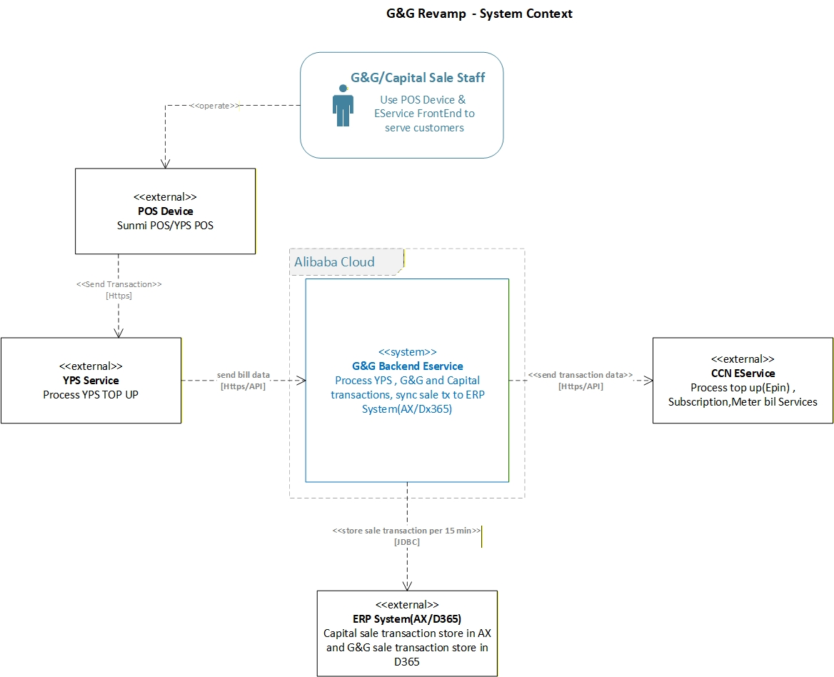
System Overview

Slide 15
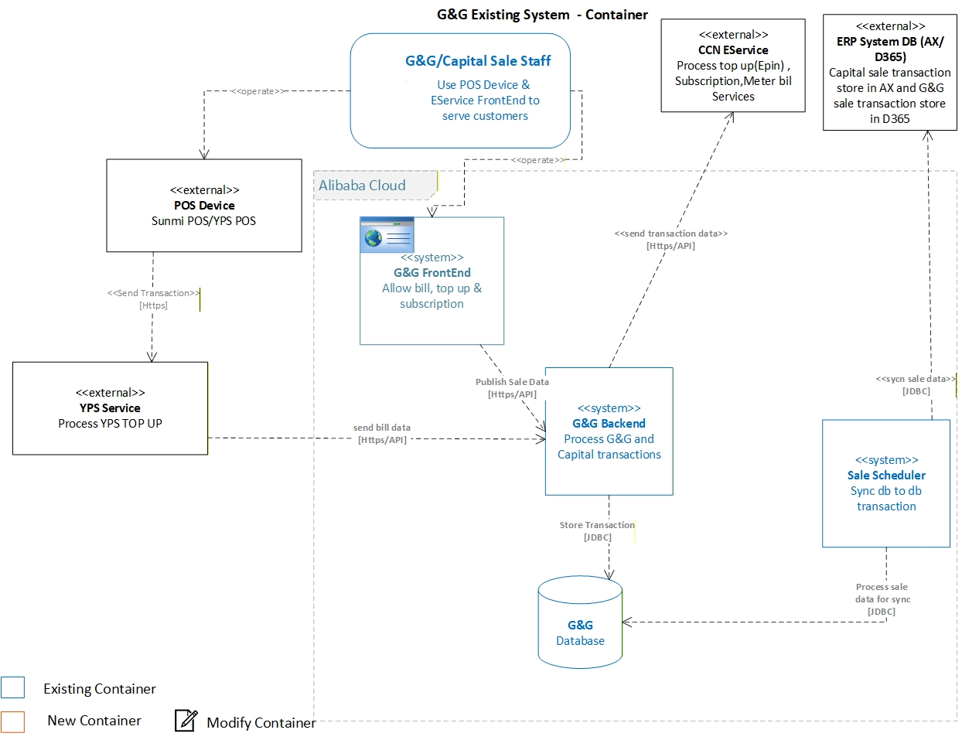
High Level Architecture (Existing System)

Slide 16
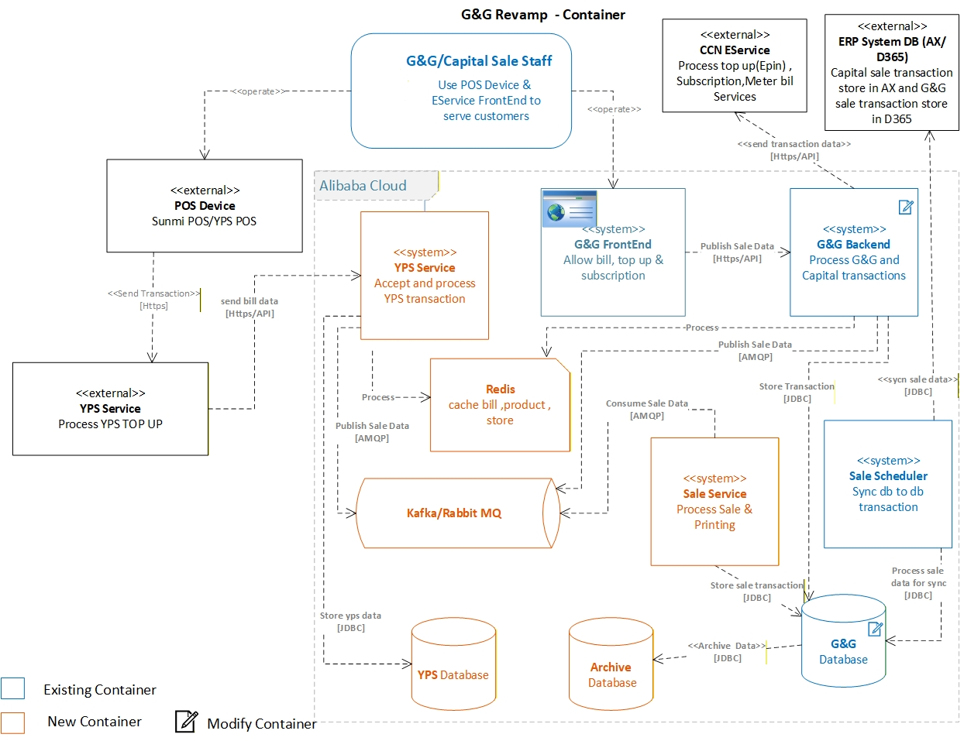
High Level Architecture

Slide 17
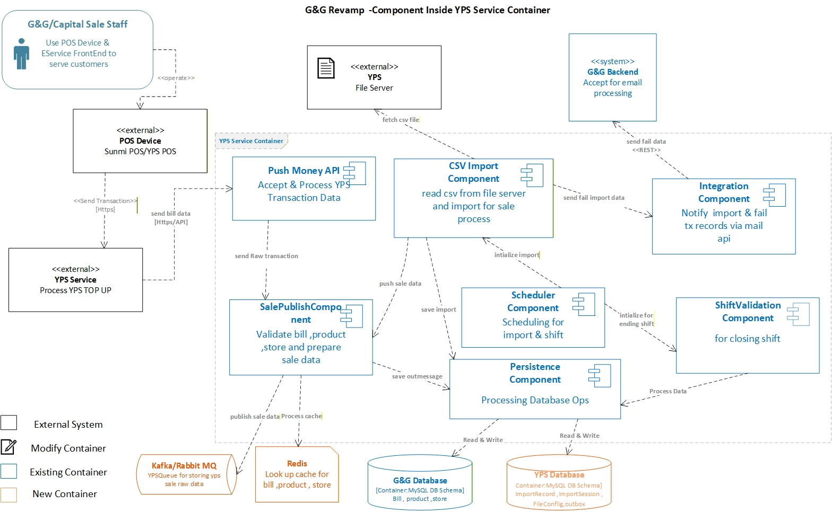
Key Components (Component Diagram for YPS)

Slide 18
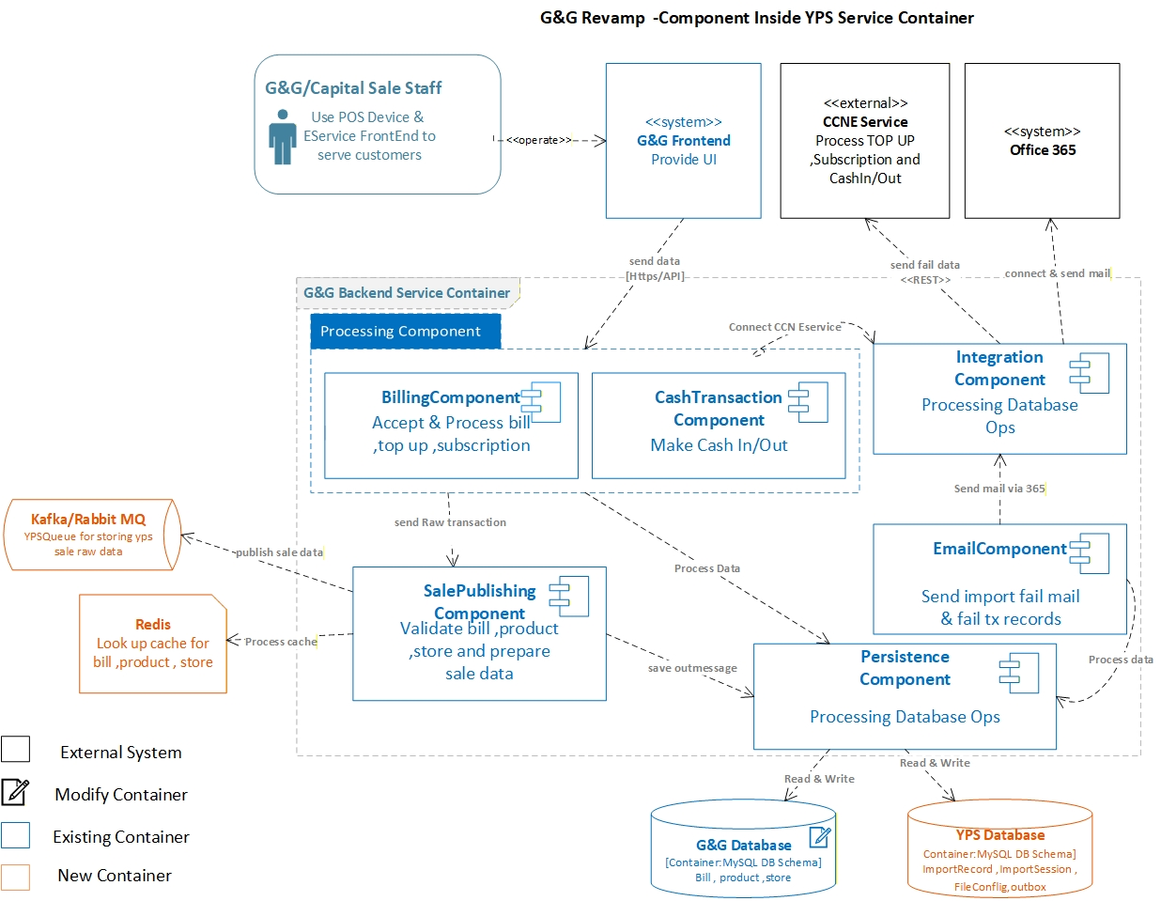
Key Components (Component Diagram for G&G)

Slide 19
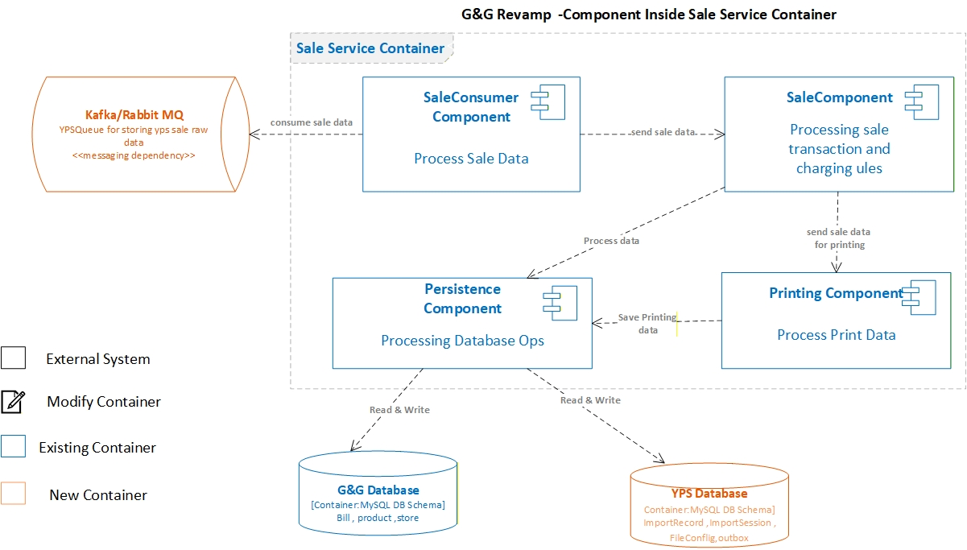
Key Components (Component Diagram for Sale Service)

Slide 20
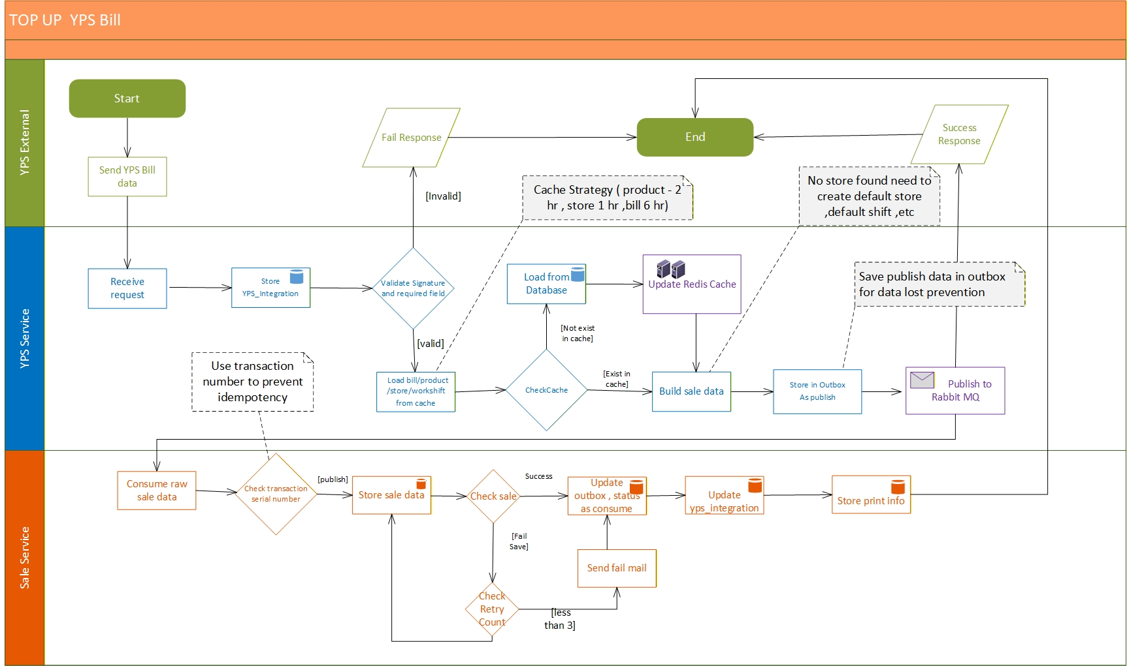
Swimlane for YPS

Slide 21
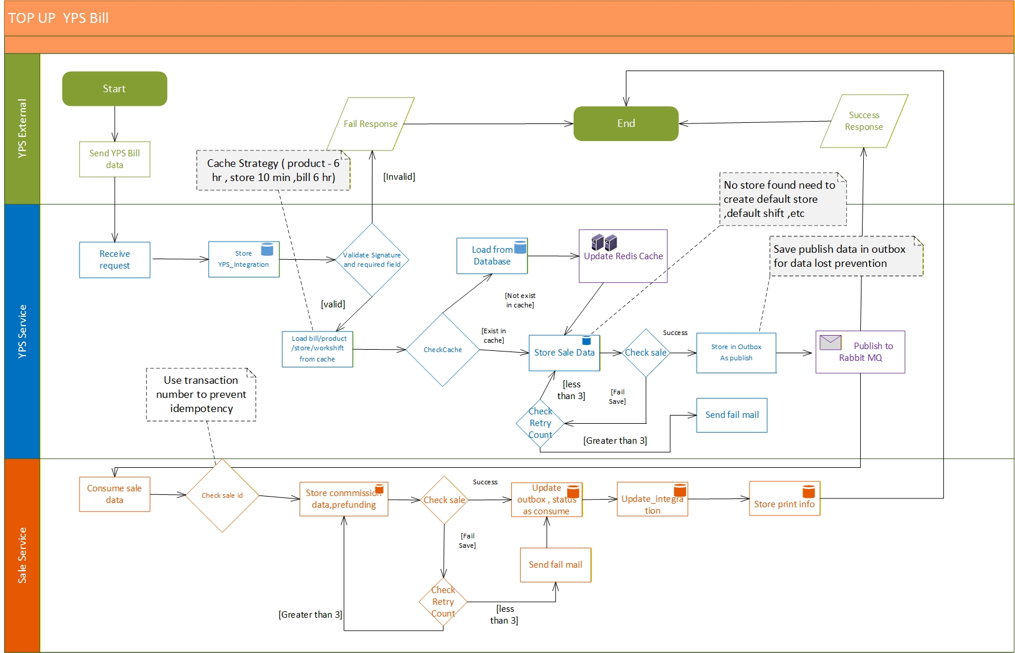
Swimlane for G&G

Slide 22
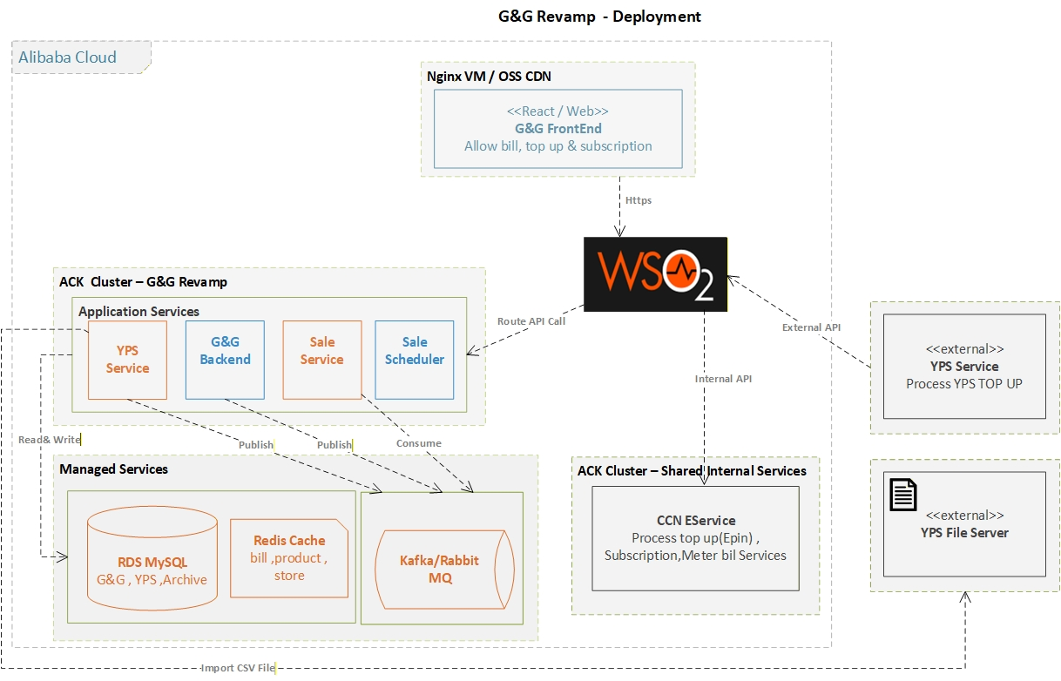
Deployment Diagram

Slide 23
Database Archival & Housekeeping
Prevent performance degradation, synchronization delays, and failed operations caused by large transaction volumes.
Data Retention Requirement
Maintain active transaction data up to 6 months in primary database
Archival Strategy
Archival Rule
Move data older than 6 months from primary DB → archive storage
Storage Design
Archive data stored in separate schema (same DB instance)
Maintain same table structure for consistency and easy access
Archival Approach
Perform monthly monitoring and batch archival
Archive in 6-month cycles (or 4-month for audit-sensitive data)
Ensure no impact on live transaction processing

Slide 24
Database Archival & Housekeeping
Housekeeping & Cleanup
Data Cleanup
Remove archived data from primary table
Maintain only latest 6 months in main DB
Optimization
Rebuild indexes after cleanup
Optimize table to improve query performance
Automation Strategy
Implement MySQL Event Scheduler for:
Scheduled archival jobs
Periodic cleanup execution
Enable controlled automation with manual monitoring
Ensure job logging and validation before data removal

Slide 25
Database Archival & Housekeeping
Future Enhancement
Implement monthly table partitioning (by transaction date)
Automate:
Partition creation
Archival process
Old data cleanup
Improve data lifecycle management and scalability

Slide 26
Thank You!

